Slide 1


CISC450 Computer Networks
Lesson 4
Multiplexing and Circuit Switching
Slides courtesy of
William Stallings (mostly)

Slide 2
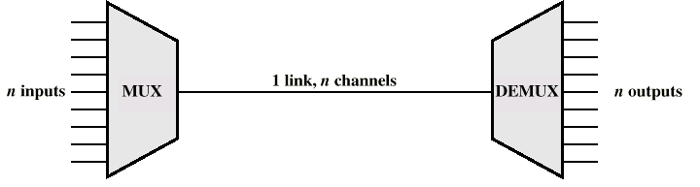
Multiplexing

Slide 3
Frequency Division Multiplexing
AKA, FDM
Useful bandwidth of medium exceeds required bandwidth of channel
Each signal is modulated to a different carrier frequency
Carrier frequencies separated so signals do not overlap (guard bands)
e.g. broadcast radio
Channel allocated even if no data

Slide 4
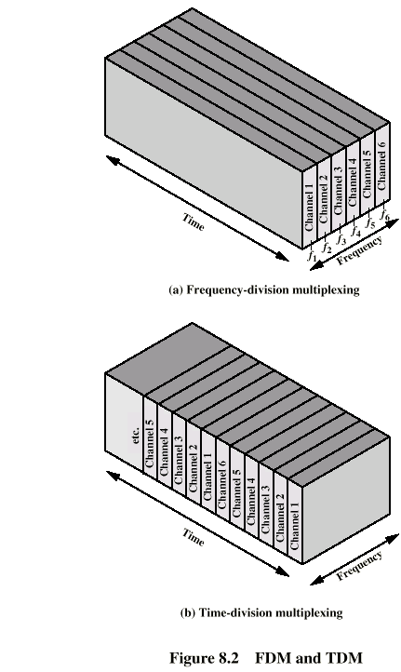
Frequency Division Multiplexing
Diagram

Slide 5
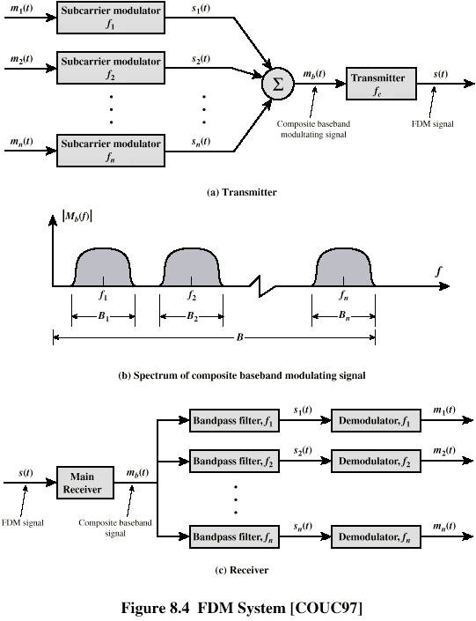
FDM System

Slide 6
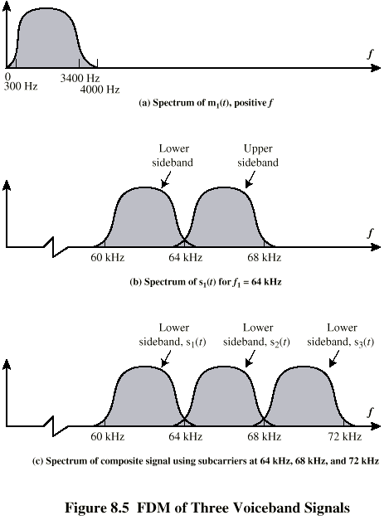
FDM of Three Voiceband Signals

Slide 7
Analog Carrier Systems
AT&T (USA)
Hierarchy of FDM schemes
Group
  12 voice channels (4kHz each) = 48kHz
  Range 60kHz to 108kHz
Supergroup
  60 channel
  FDM of 5 group signals on carriers between 420kHz and 612 kHz
Mastergroup
  10 supergroups

Slide 8
Synchronous Time Division Multiplexing
Data rate of medium exceeds data rate of digital signal to be transmitted
Multiple digital signals interleaved in time
May be at bit level of blocks
Time slots preassigned to sources and fixed
Time slots allocated even if no data
Time slots do not have to be evenly distributed amongst sources

Slide 9
Time Division Multiplexing

Slide 10
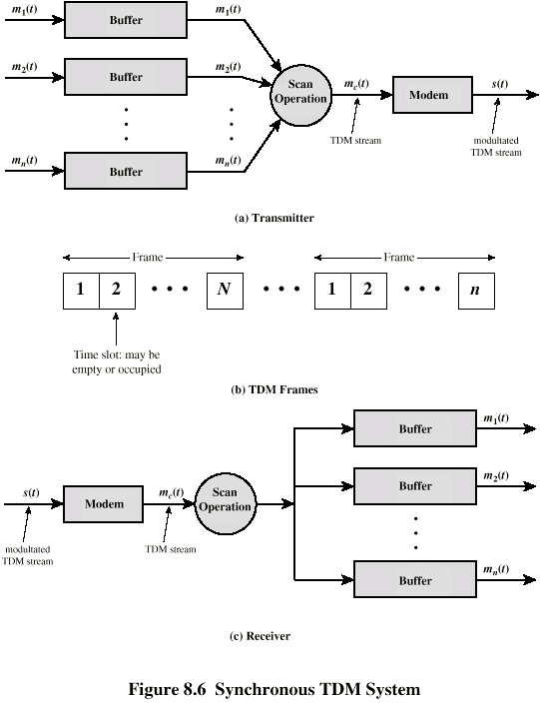
TDM System

Slide 11
TDM Link Control
No headers and trailers
Data link control protocols not needed
Flow control
  Data rate of multiplexed line is fixed
  If one channel receiver can not receive data, the others must carry on
  The corresponding source must be quenched
  This leaves empty slots (in time)
Error control
  Errors are detected and handled by individual channel systems

Slide 12
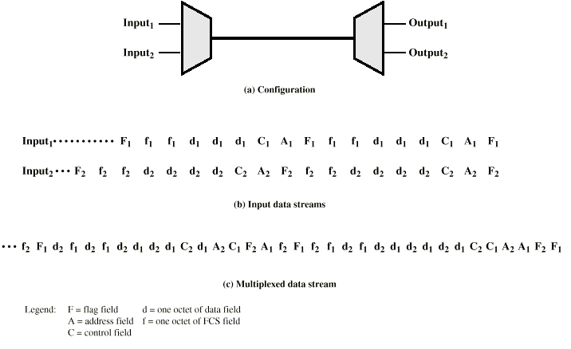
Bit vs. Byte
Interleaving
Data Link Control on TDM

Slide 13
Framing
No flag or SYNC characters bracketing TDM frames
Must provide synchronizing mechanism
Added digit framing
  One control bit added to each TDM frame
    Looks like another channel - “control channel”
  Identifiable bit pattern used on control channel
  e.g. alternating 01010101…unlikely on a data channel
  Can compare incoming bit patterns on each channel with sync pattern

Slide 14
Pulse Stuffing
Problem - Synchronizing data sources
Clocks in different sources drifting
Data rates from different sources not related by simple rational number
Solution - Pulse Stuffing
  Outgoing data rate (excluding framing bits) higher than sum of incoming rates
  Stuff extra dummy bits or pulses into each incoming signal until it matches local clock
  Stuffed pulses inserted at fixed locations in frame and removed at demultiplexer

Slide 15
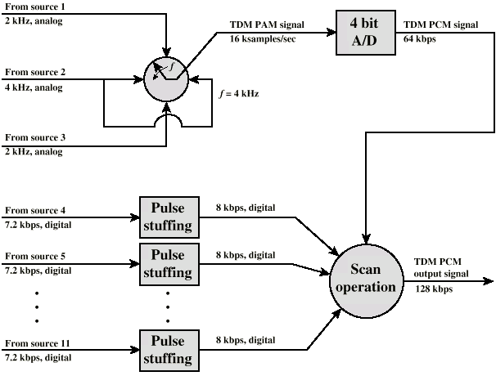
TDM of Analog and Digital Sources

Slide 16
Digital Carrier Systems
Hierarchy of TDM
USA/Canada/Japan use one system
ITU-T use a similar (but different) system
US system based on DS-1 format
Multiplexes 24 channels
Each frame has 8 bits per channel plus one framing bit
193 bits per frame

Slide 17
Digital Carrier Systems (2)
For voice each channel contains one word of digitized data (PCM, 8000 samples per sec)
  Data rate 8000x193 = 1.544Mbps
  Five out of six frames have 8 bit PCM samples
  Sixth frame is 7 bit PCM word plus signaling bit
  Signaling bits form stream for each channel containing control and routing info
Same format for digital data
  23 channels of data
    7 bits per frame plus indicator bit for data or systems control
  24th channel is sync

Slide 18
Mixed Data
DS-1 can carry mixed voice and data signals
24 channels used
No sync byte
Can also interleave DS-1 channels
  Ds-2 is four DS-1 giving 6.312Mbps

Slide 19
ISDN User Network Interface
ISDN allows multiplexing of devices over single ISDN line
Two interfaces
  Basic ISDN Interface
  Primary ISDN Interface

Slide 20
Basic ISDN Interface (1)
Digital data exchanged between subscriber and NTE - Full Duplex
Separate physical line for each direction
Data rate 192kbps
Basic access is two 64kbps B channels and one 16kbps D channel
This gives 144kbps multiplexed over 192kbps
Remaining capacity used for framing and sync

Slide 21
Basic ISDN Interface (2)
B channel is basic user channel
Data/video/fax or PCM voice
Separate logical 64kbps connections o different destinations
D channel used for control or data
  LAPD frames
Each frame 48 bits long
One frame every 250μs

Slide 22
Primary Rate ISDN
Point to point
Typically supporting PBX trunking, high-speed data, modem banks
1.544Mbps
  Based on US DS-1
  Used on T1 services
  23 B plus one D channel

Slide 23
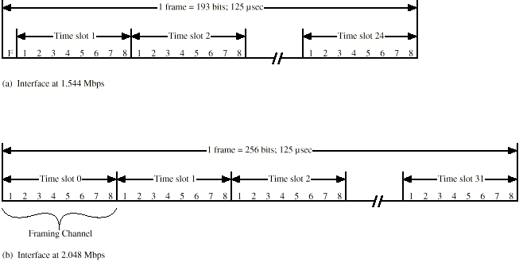
Primary ISDN Frame Formats

Slide 24
Sonet/SDH
Synchronous Optical Network (ANSI)
Synchronous Digital Hierarchy (ITU-T)
Compatible
Signal Hierarchy
  Synchronous Transport Signal level 1 (STS-1) or Optical Carrier level 1 (OC-1)
  51.84Mbps
  Carry DS-3 or group of lower rate signals (DS1 DS1C DS2) plus ITU-T rates (e.g. 2.048Mbps)
  Multiple STS-1 combined into STS-N signal
  ITU-T lowest rate is 155.52Mbps (STM-1)

Slide 25
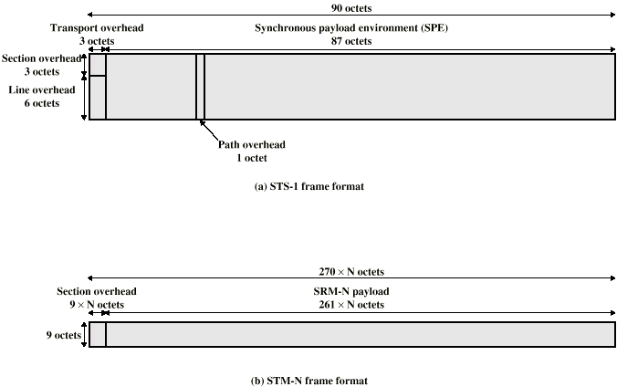
SONET Frame Format

Slide 26
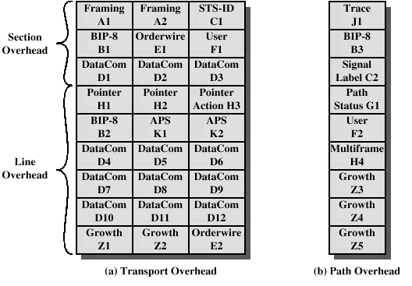
SONET STS-1 Overhead Octets

Slide 27
Statistical TDM
In Synchronous TDM many slots are wasted
Statistical TDM allocates time slots dynamically based on demand
Multiplexer scans input lines and collects data until frame full
Data rate on line lower than aggregate rates of input lines

Slide 28
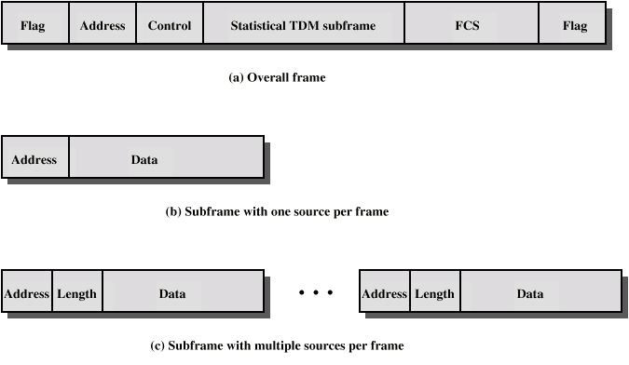
Statistical TDM Frame Formats

Slide 29
Performance
Output data rate less than aggregate input rates
May cause problems during peak periods
  Buffer inputs
  Keep buffer size to minimum to reduce delay

Slide 30
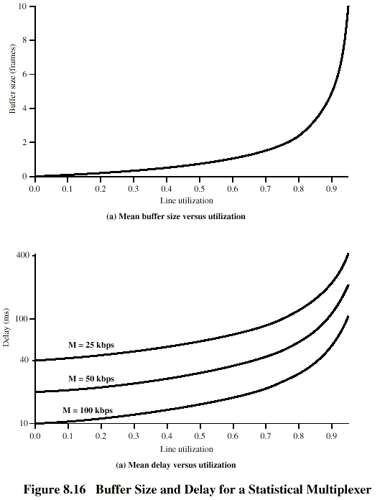
Buffer Size and Delay

Slide 31
Asymmetrical Digital Subscriber Line
ADSL
Link between subscriber and network
  Local loop
Uses currently installed twisted pair cable
  Can carry broader spectrum
  1 MHz or more

Slide 32
ADSL Design
Asymmetric
  Greater capacity downstream than upstream
Frequency division multiplexing
  Lowest 25kHz for voice
    Plain old telephone service (POTS)
  Use echo cancellation or FDM to give two bands
  Use FDM within bands
Range 5.5km

Slide 33
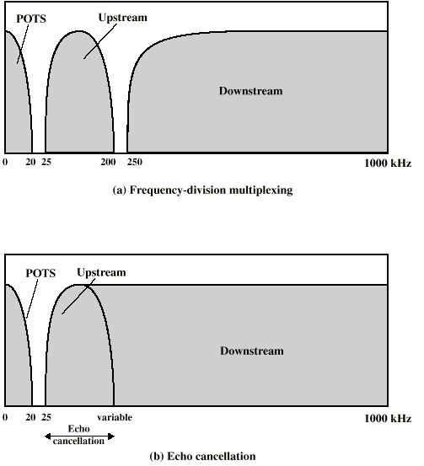
ADSL Channel Configuration

Slide 34
Discrete Multitone
DMT
Multiple carrier signals at different frequencies
Some bits on each channel
4kHz subchannels
Send test signal and use subchannels with better signal to noise ratio
256 downstream subchannels at 4kHz (60kbps)
  15.36MHz
  Impairments bring this down to 1.5Mbps to 9Mbps

Slide 35
xDSL
High data rate DSL
Single line DSL
Very high data rate DSL

Slide 36
Switching Networks
Long distance transmission is typically done over a network of switched nodes
Nodes not concerned with content of data
End devices are stations
  Computer, terminal, phone, etc.
A collection of nodes and connections is a communications network
Data routed by being switched from node to node

Slide 37
Nodes
Nodes may connect to other nodes only, or to stations and other nodes
Node to node links usually multiplexed
Network is usually partially connected
  Some redundant connections are desirable for reliability
Two different switching technologies
  Circuit switching
  Packet switching

Slide 38
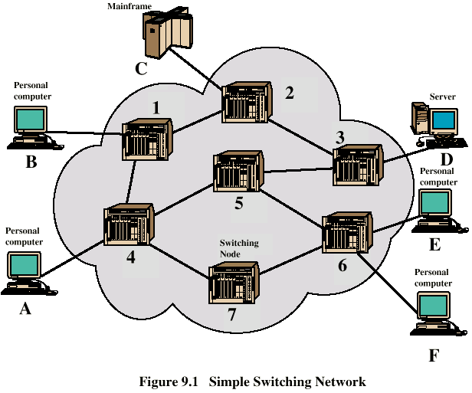
Simple Switched Network

Slide 39
Circuit Switching
Dedicated communication path between two stations
Three phases
  Establish
  Transfer
  Disconnect
Must have switching capacity and channel capacity to establish connection
Must have intelligence to work out routing

Slide 40
Circuit Switching - Applications
Inefficient
  Channel capacity dedicated for duration of connection
  If no data, capacity wasted
Set up (connection) takes time
Once connected, transfer is transparent
Developed for voice traffic (phone)

Slide 41
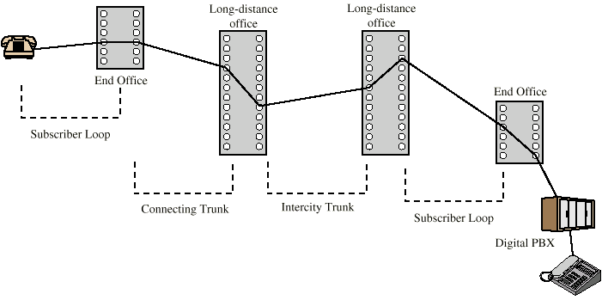
Public Circuit Switched Network
AKA, PSTN

Slide 42
PSTN Components
Subscriber
  Devices attached to network
Local Loop
  Subscriber loop
  Connection to network
Exchange
  Switching centers
  End office - supports subscribers
Trunks
  Branches between exchanges
  Multiplexed

Slide 43
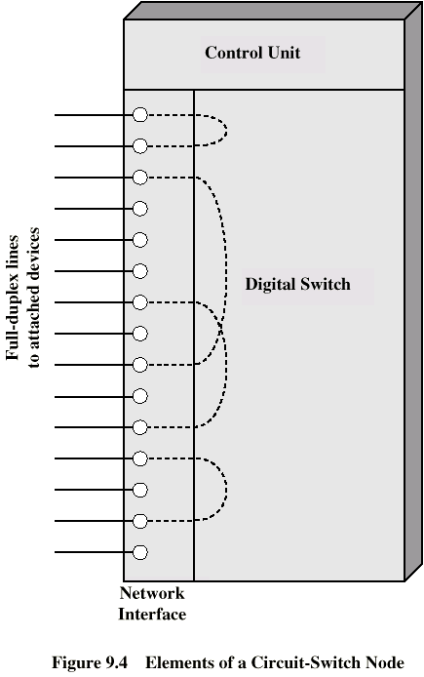
Circuit Switch Elements

Slide 44
Circuit Switching Concepts
Digital Switch
  Provide transparent signal path between devices
Network Interface
Control Unit
  Establish connections
    Generally on demand
    Handle and acknowledge requests
    Determine if destination is free
    construct path
  Maintain connection
  Disconnect

Slide 45
Blocking or Non-blocking
Blocking
  A network is unable to connect stations because all paths are in use
  A blocking network allows this
  Used on voice systems
    Short duration calls
Non-blocking
  Permits all stations to connect (in pairs) at once
  Used for some data connections

Slide 46
Space Division Switching
Developed for analog environment
Separate physical paths
Crossbar switch
  Number of crosspoints grows as square of number of stations
  Loss of a crosspoint prevents connection
  Inefficient use of crosspoints
    All stations connected, only a few crosspoints in use
  Non-blocking

Slide 47
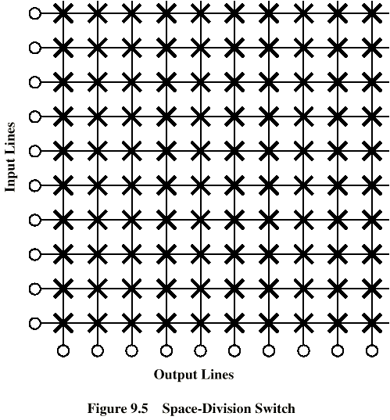
Crossbar Matrix

Slide 48
Multistage Switch
Reduced number of crosspoints
More than one path through network
  Increased reliability
More complex control
May be blocking

Slide 49
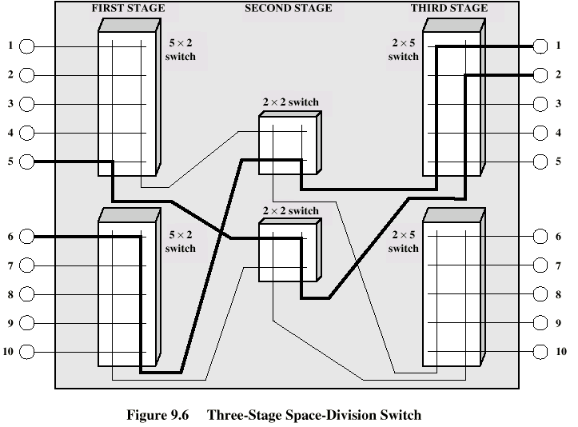
Three Stage Switch

Slide 50
Time Division Switching
Partition low speed bit stream into pieces that share higher speed stream
e.g. TDM bus switching
  based on synchronous time division multiplexing
  Each station connects through controlled gates to high speed bus
  Time slot allows small amount of data onto bus
  Another line’s gate is enabled for output at the same time

Slide 51
Routing
Many connections will need paths through more than one switch
Need to find a route
  Efficiency
  Resilience
Public telephone switches are a tree structure
  Static routing uses the same approach all the time
Dynamic routing allows for changes in routing depending on traffic
  Uses a peer structure for nodes

Slide 52
Alternate Routing
Possible routes between end offices predefined
Originating switch selects appropriate route
Routes listed in preference order
Different sets of routes may be used at different times

Slide 53
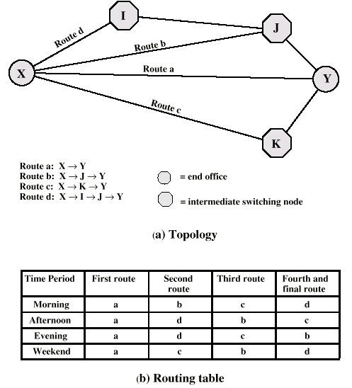
Alternate Routing Diagram

Slide 54
Control Signaling Functions
Audible communication with subscriber
Transmission of dialed number
Call can not be completed indication
Call ended indication
Signal to ring phone
Billing info
Equipment and trunk status info
Diagnostic info
Control of specialist equipment

Slide 55
Control Signal Sequence
Both phones on hook
Subscriber lifts receiver (off hook)
End office switch signaled
Switch responds with dial tone
Caller dials number
If target not busy, send ringer signal to target subscriber
Feedback to caller
  Ringing tone, engaged tone, unobtainable
Target accepts call by lifting receiver
Switch terminates ringing signal and ringing tone
Switch establishes connection
Connection release when Source subscriber hangs up

Slide 56
Switch to Switch Signaling
Subscribers connected to different switches
Originating switch seizes inter-switch trunk
Send off hook signal on trunk, requesting digit register at target switch (for address)
Terminating switch sends off hook followed by on hook (wink) to show register ready
Originating switch sends address

Slide 57
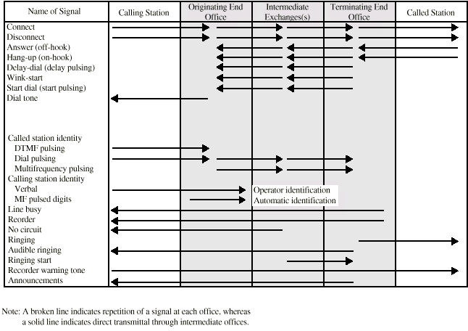
Control Signals

Slide 58
Location of Signaling
Subscriber to network
  Depends on subscriber device and switch
Within network
  Management of subscriber calls and network
  more complex

Slide 59
In Channel Signaling
Use same channel for signaling and call
  Requires no additional transmission facilities
Inband
  Uses same frequencies as voice signal (SF,MF,DTMF)
  Can go anywhere a voice signal can
  Impossible to set up a call on a faulty speech path
Out of band
  Voice signals do not use full 4kHz bandwidth
  Narrow signal band within 4kHz used for control
  Can be sent whether or not voice signals are present
  Need extra electronics
  Slower signal rate (narrow bandwidth)

Slide 60
Drawbacks of In Channel Signaling
Limited transfer rate
Delay between entering address (dialing) and connection
Overcome by use of common channel signaling
FRAUD (blue box, Captain Crunch)

Slide 61
Common Channel Signaling
Control signals carried over paths independent of voice channel
One control signal channel can carry signals for a number of subscriber channels
Common control channel for these subscriber lines
Associated Mode
  Common channel closely tracks interswitch trunks
Disassociated Mode
  Additional nodes (signal transfer points)
  Effectively two separate networks

Slide 62
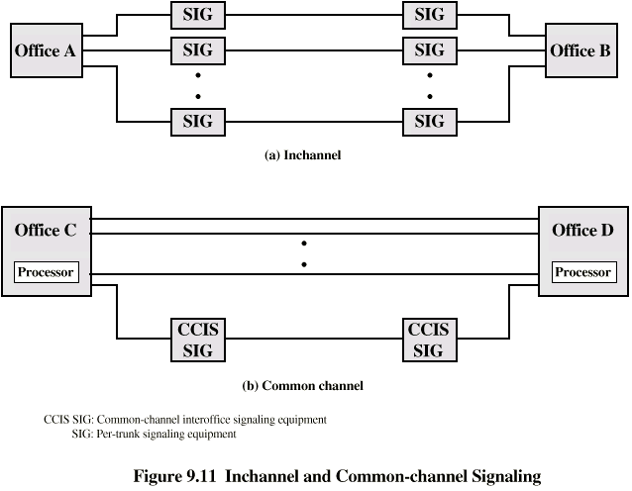
Common v. In Channel Signaling

Slide 63
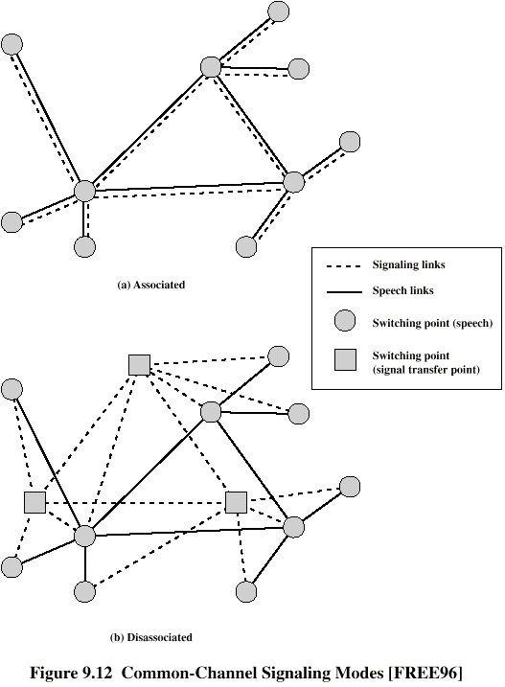
Signaling
Modes

Slide 64
Signaling System Number 7
SS7
Common channel signaling scheme
ISDN
Optimized for 64k digital channel network
Call control, remote control, management and maintenance
Reliable means of transfer of info in sequence
Will operate over analog and below 64k
Point to point terrestrial and satellite links

Slide 65
SS7
Signaling Network Elements
Signaling point (SP)
  Any point in the network capable of handling SS7 control message
Signal transfer point (STP)
  A signaling point capable of routing control messages
Control plane
  Responsible for establishing and managing connections
Information plane
  Once a connection is set up, info is transferred in the information plane

Slide 66
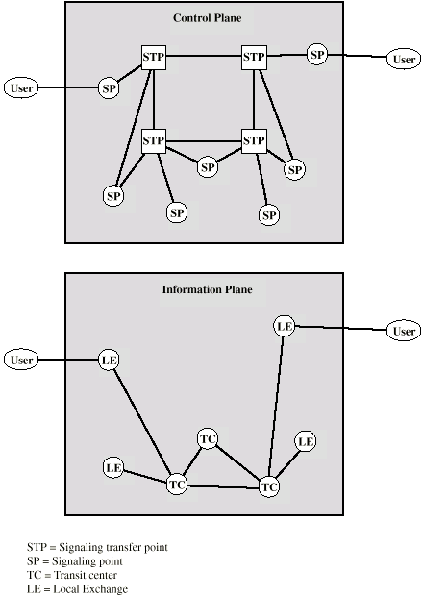
Transfer Points

Slide 67
Signaling Network Structures
STP capacities
  Number of signaling links that can be handled
  Message transfer time
  Throughput capacity
Network performance
  Number of STPs
  Signaling delays
Availability and reliability
  Ability of network to provide services in the face of STP failures
  Points of failure

